Slide 1
Path Planning using OMPL
Simone Giacomelli
Olivier Chapeau
Oleg Borisov

Slide 2
OMPL
Implements many sampling based algorithms (RRT, PRM, KPIECE1etc.)
C++/Python bindings
Provides GUI
Benchmark tools

Slide 3
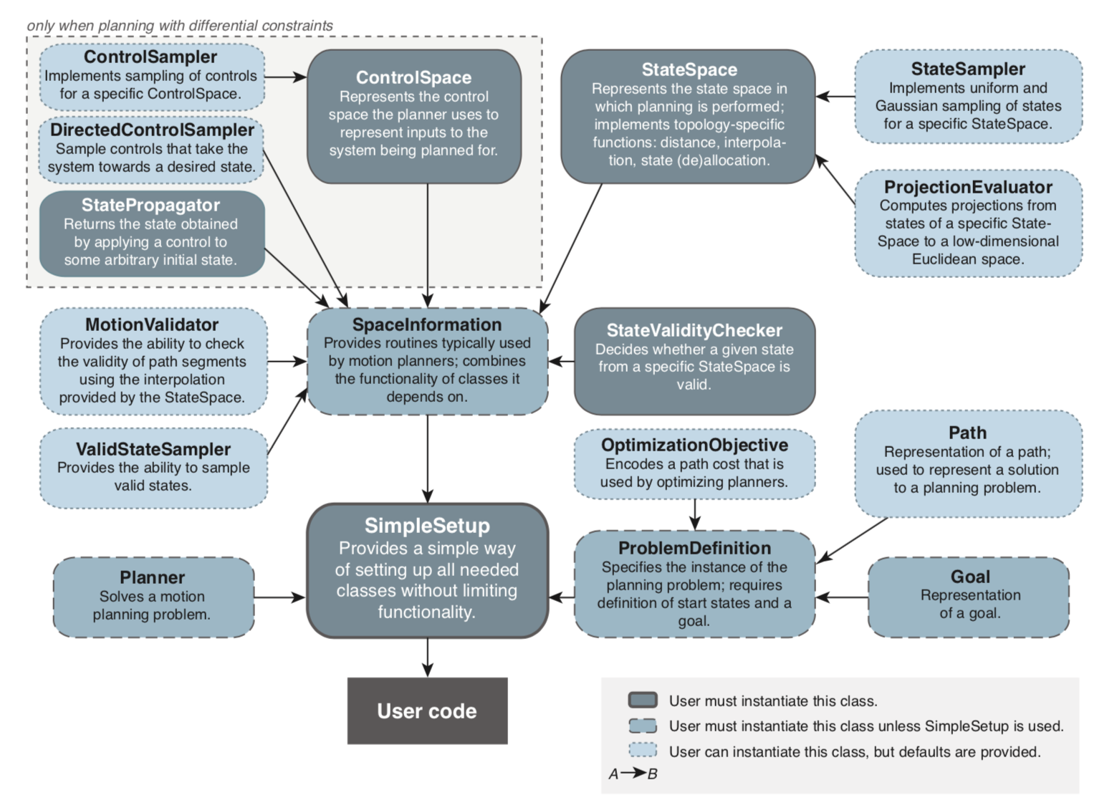

Slide 4
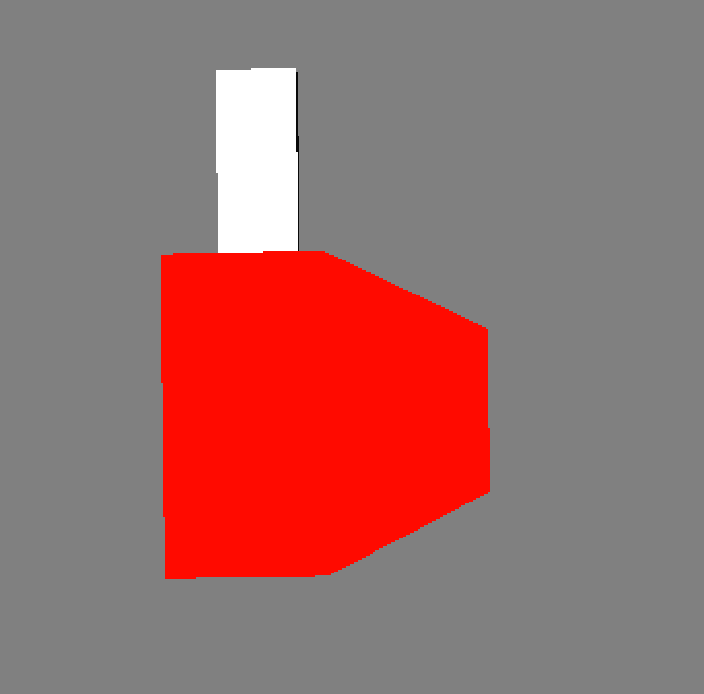

Our objectives
DDR with the broken wheel: One wheel cannot have negative velocity | DDR with the sticking bar

Slide 5
Important steps
Define the propagator (DDR Kinematics)
Define control and state space
Choose the planner

Slide 6
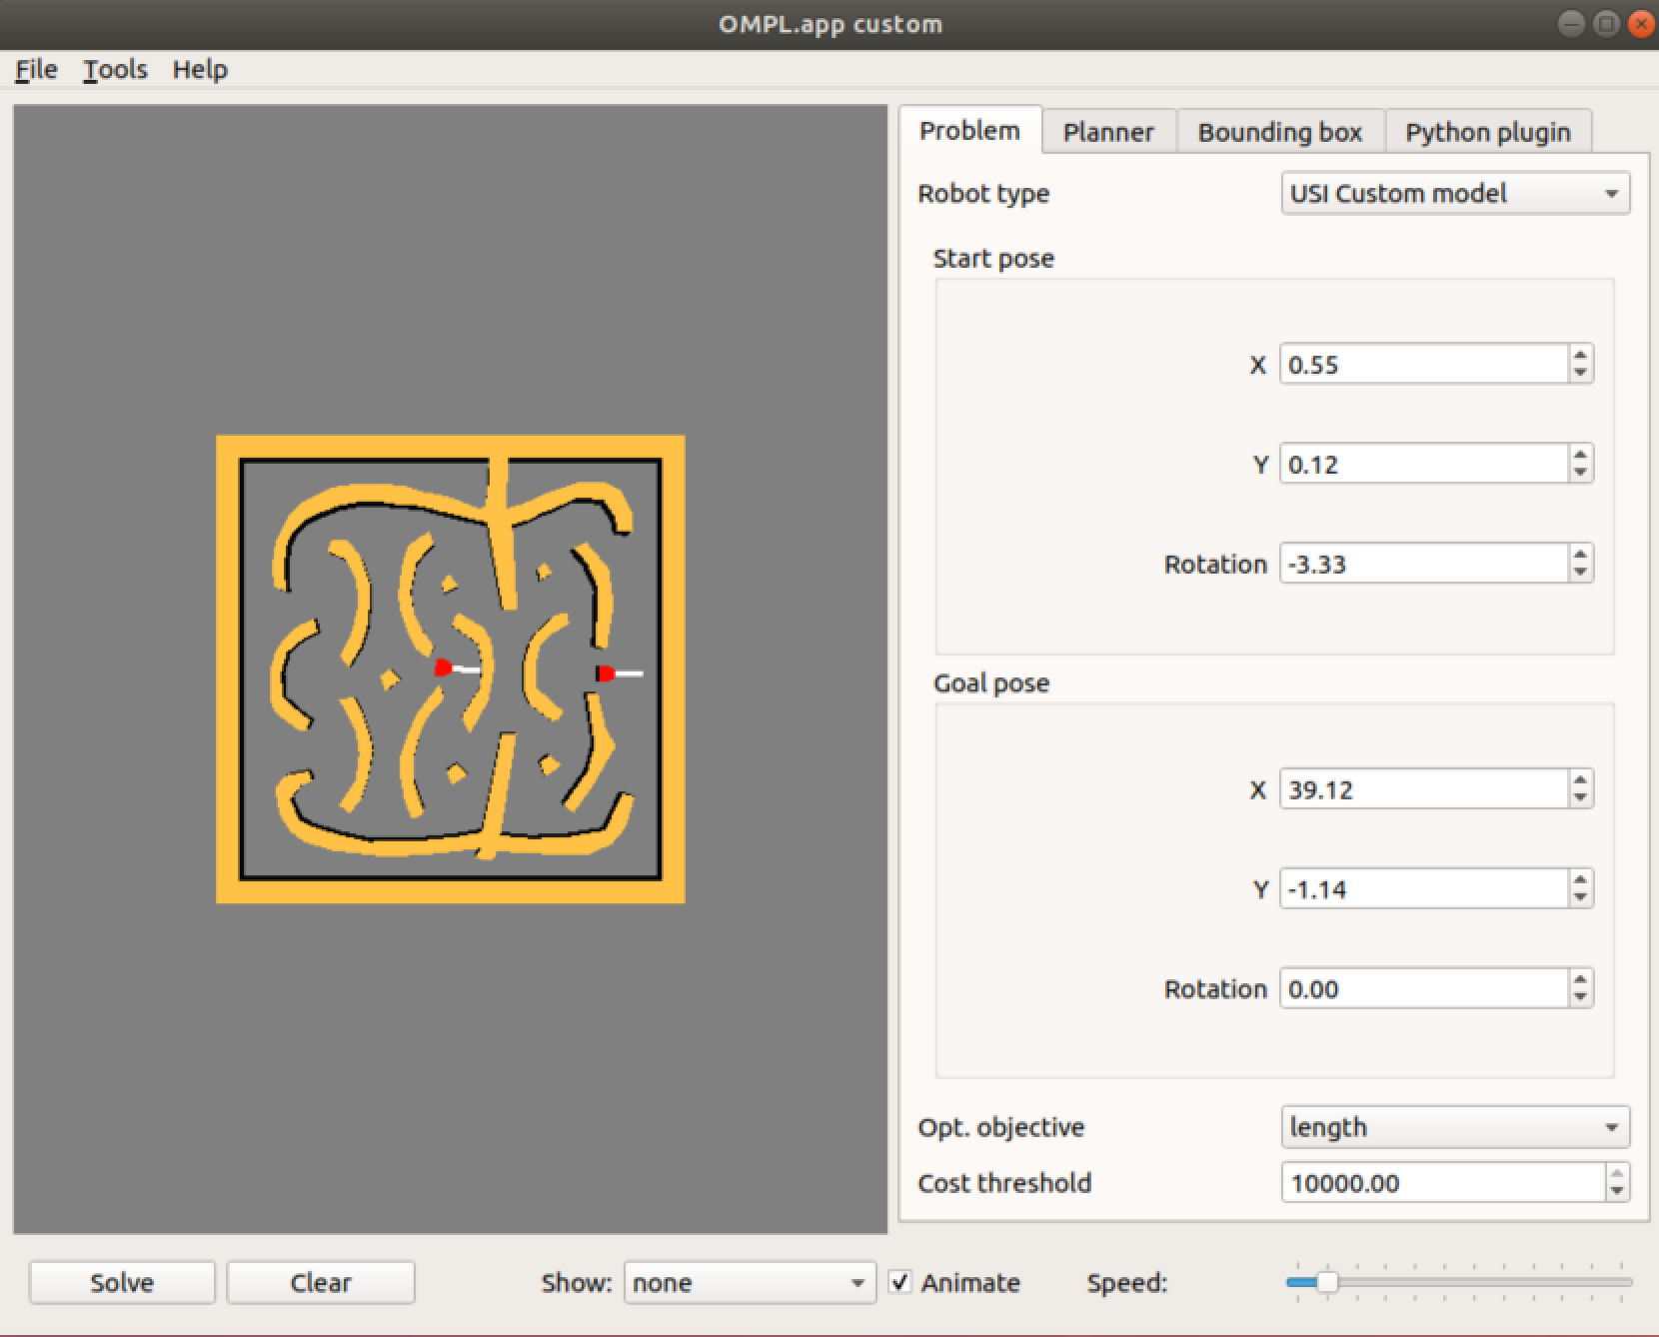
GUI improvement

Slide 7
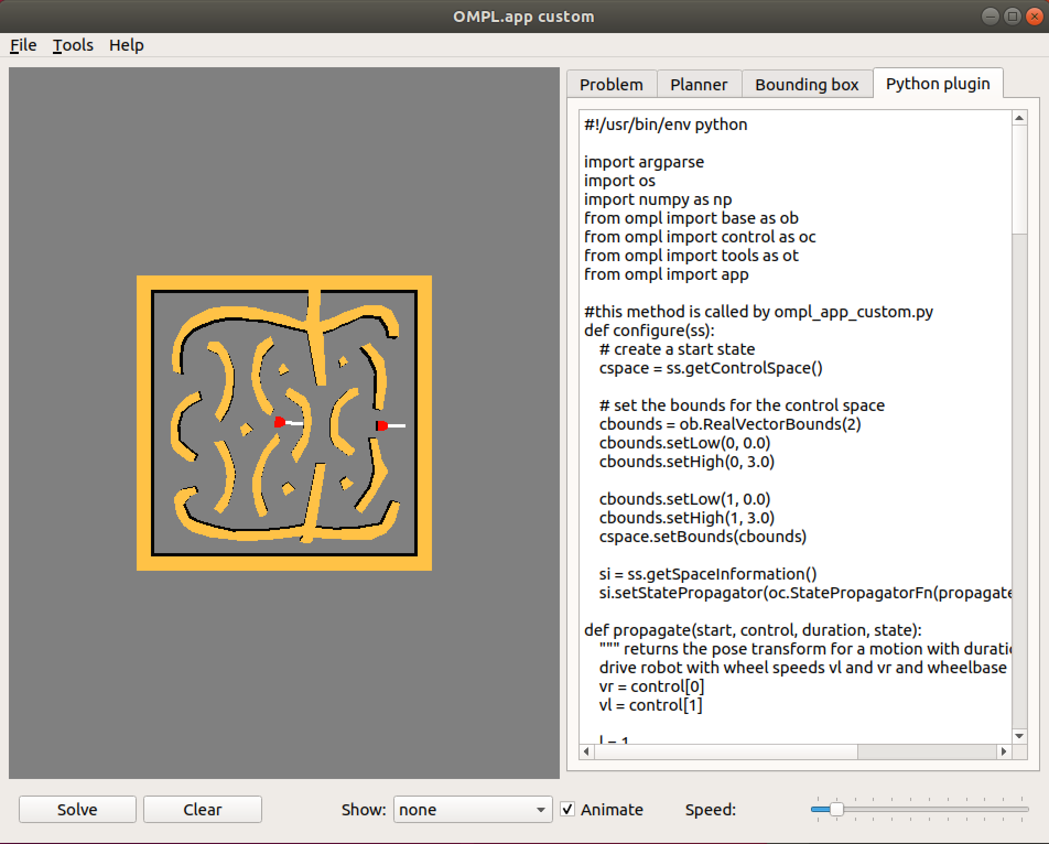
GUI improvement

Slide 8
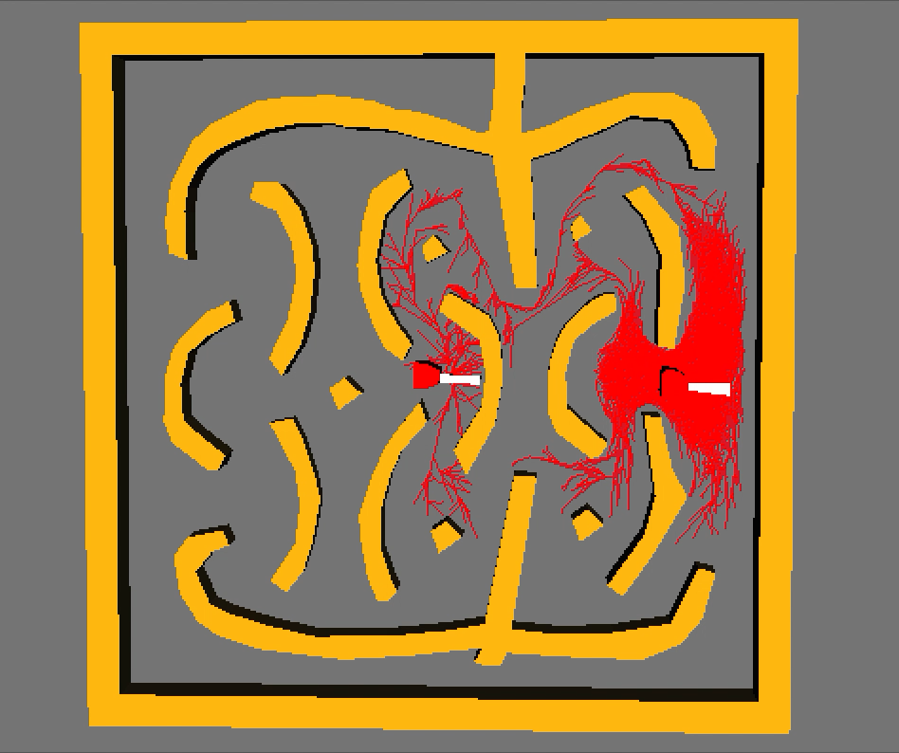
Syclop RRT

